Slide 1


Today’s Agenda
Database Programming
What Is Data And Database ?
What Is DBMS ?
What Is SQL ?

Slide 2
Introduction
Before we learn about Database Programming In Python, let's first understand -
What is Data?
What is Database ?

Slide 3
Introduction
What is Data?
In simple words data can be facts or information.
For example your name, population of a country , names of political parties in your country , today’s temperature etc
A picture , image , file , pdf etc can also be considered data.

Slide 4
Introduction
What is a Database?
A database is a collection of inter-related data or information that is organized so that it can easily be accessed, managed, and updated .
Let's discuss few examples.
Your mobile’s phone book is a database as it stores data pertaining to people like their phone numbers, name and other contact details etc.
Your University uses database to store student details like enrollment no, name , address , academic performance etc
Let's also consider the Facebook. It needs to store, manipulate and present data related to members, their friends, member activities, messages, advertisements and lot more. Here also database is used

Slide 5
How Databases Store The Data ?
Most of the databases store their data in the form of tables
Each table in a database has one or more columns, and each column is assigned a specific data type, such as an integer number, a sequence of characters (for text), or a date.
Each row in the table has a value for each column.

Slide 6
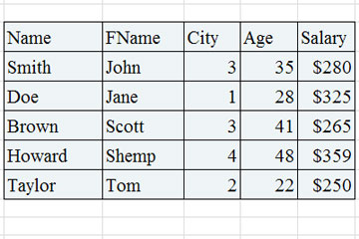
How Databases Store The Data ?

Slide 7
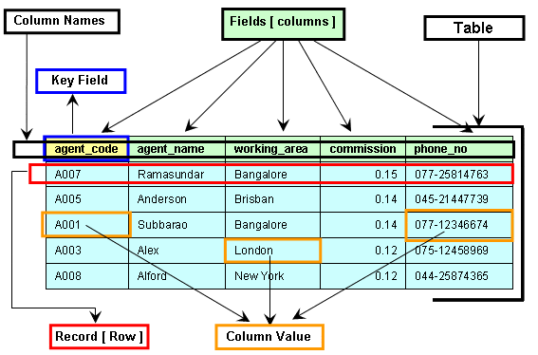
Components Of A Table

Slide 8
What Is A DBMS ?
A DBMS is a program or a software that allows users to perform different operations on a database.
These operations include:
Creating the database/tables
Inserting records into these tables
Selecting records from these tables for displaying
Updating / Deleting the records

Slide 9
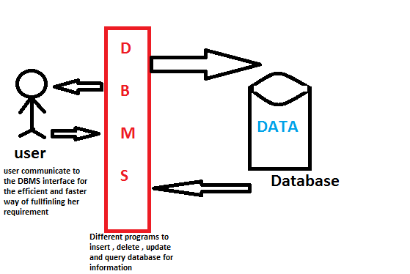
What Is A DBMS ?

Slide 10
Some Popular DBMS
Some of the most popular DBMS are:
Oracle
MySQL
MS SQL Server
SQLite
PostgreSQL
IBM DB2
and many more

Slide 11
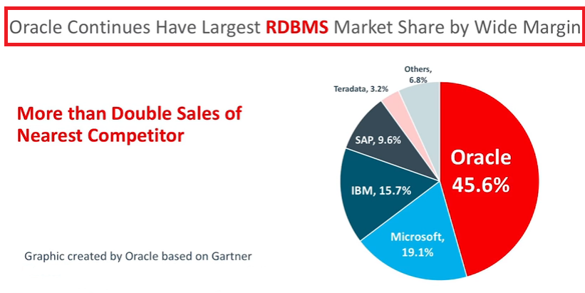
The Market Leader

Slide 12
What Is SQL ?
SQL is an abbreviation for “Structured Query Language”.
It is a language used by EVERY DBMS to interact with the database.
It provides us COMMANDS for inserting data to a database, selecting data from the database and modifying data in the database

Slide 13
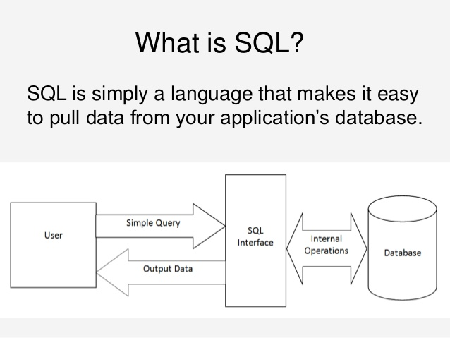
Pictorial View Of SQL

Slide 14
Oracle Database is available in five editions, but three editions amongst them are more common and popular.
These are:
Oracle Enterprise Edition
Oracle Standard Edition
Oracle Express Edition
For learning purpose all are free to download but for commercial use first 2 are paid while 3rd one is free for commercial use also

Slide 15
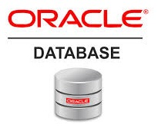
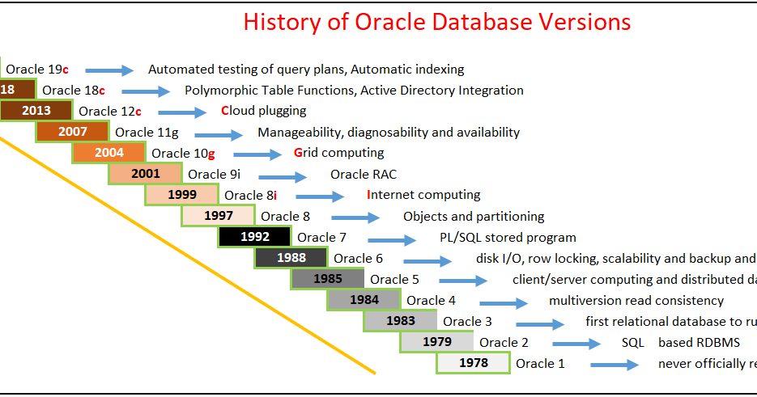
History Of Oracle

Slide 16
SQL Commands
Learning SQL commands is the first step towards learning SQL.
Although there are many SQL commands but collectively they can be grouped in 5 categories and they are:
DDL : Data Definition Language
DML: Data Manipulation Language
DQL: Data Query Language
DCL: Data Control Language
TCL: Transaction Control Language

Slide 17
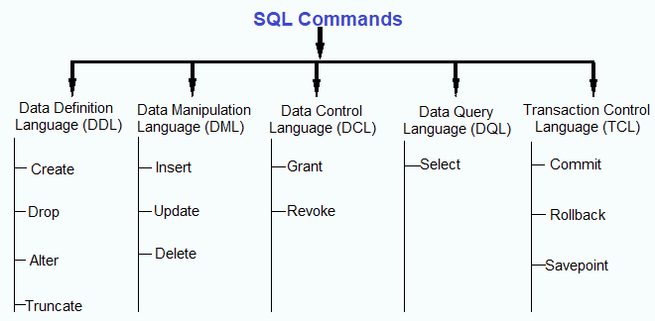
Categories Of SQL Commands

Slide 18
Data Definition Language
These commands are:
CREATE TABLE
Used for creating a new table in the database
ALTER TABLE
Used altering structure of the table like adding /removing cols etc.
TRUNCATE TABLE
Used for deleting all rows from a table and free the space containing the table
DROP TABLE
Used for deleting an entire table from the database and all the data stored in it.

Slide 19
Data Manipulation Language
The DML or Data Manipulation Language commands help in modifying the contents of the table..
These commands are not auto-committed, which simply means that all changes made to the table using DML commands aren’t automatically saved.

Slide 20
Data Manipulation Language
These commands are:
INSERT
Used for inserting a new row in the table
UPDATE
Used to modifying the value of a column of a row in a table. It can update all rows or some selective rows
DELETE
Used for removing one or more rows from a table.

Slide 21
Data Query Language
The DQL command is used for fetching data from a relational database.
There is only one command in this category , which is the SELECT command.
SELECT command selects the attribute based on the condition described by the WHERE clause.

Slide 22
Data Control Language
In order to protect the information in a table from unauthorized access, the DCL commands are used.
A DCL command can either enable or disable a user from accessing information from a database.

Slide 23
Data Control Language
These commands are:
GRANT
Used for granting user access privileges to a table
REVOKE
Used for taking back permission given to a user.

